Slide 1
Section 1.6 Applications and Challenging Problems with Rational Functions:

Slide 2
Applications of Rational Functions
There are many applications of rational functions that are not taught anymore if PC11
One important application of R.F. is anything that has to do with speed, time, and distance (STD)
When travelling by plane, car, or train, knowing how time can be affected by your change in speed
Vehicles have “optimal fuel efficiency”, to travel faster means burning more fuel → reduce time, increases cost
Another application is the effect of drag, windspeed, headwind vs tailwind
Speed, Time, Distance (STD)

Slide 3
Application#1: Rate of Work Problems
Rate of Work problems are usually about 2 or more people working together to complete a task
Ie: To paint a house alone, Sam would need 4 hours, Tim 6 hours, and Sara 5 hours. How long would it take for them to paint it together?
Think of these problems as percentages, each person does their part (percentage) to complete the job (100%)
Inside each box is a fraction that represent how much each person completes
Let “x” be the time that it takes to complete when working together
Sam
Tim
Sara
100% means that the job is complete
+
+
=
100%
The denominators are the individual times when working alone
Solve this equation for “x”

Slide 4
Ex: Mike can mow his lawn in 2h and his brother Tim can mow in 4h. How long will it take if they work together?
% of Mike’s Work:
% of Tim’s Work:
It will take 4/3 of an hour if they work together

Slide 5
Q1: Together, Larry and Stew can do a job in 72minutes. Individually, Larry takes an hour longer than Stew. How long does it take Larry to do the job by himself?
Q2: To complete a task individually, Sith requires 45min. more than Cindy, and Chester needs twice the time as Sith. Suppose they finished the task together in 3.5hours, with Cindy starting 15min early, how long does it take each person to complete it individually?

Slide 6
Appl. #2) Travelling Questions w/ Different Speeds
These questions involves 2 or more different vehicles of transportations, ie: Car, bike, plane, spaceship….
A car can travel 400km 8 times faster than Tom. Tom needs 4.5 hours more than the car. How fast can Tom run?
Create a chart with S, T, D (always make a chart!)
Distance is usually the same
The difference in time is 4.5 hours
Tom’s time minus Car’s time is 4.5h
Solve this equation for Tom’s running speed!

Slide 7
Practice: Jack and Steven are both leaving Portland for Bellingham (300km). Jack is taking the plane and Steven is driving a fast car. If Jack travels 320km/h faster and requires 4.5 hours less, how fast is each person travelling?
Equation:
Gather Information
Difference in time is 4.5h
Solve for “x”

Slide 8
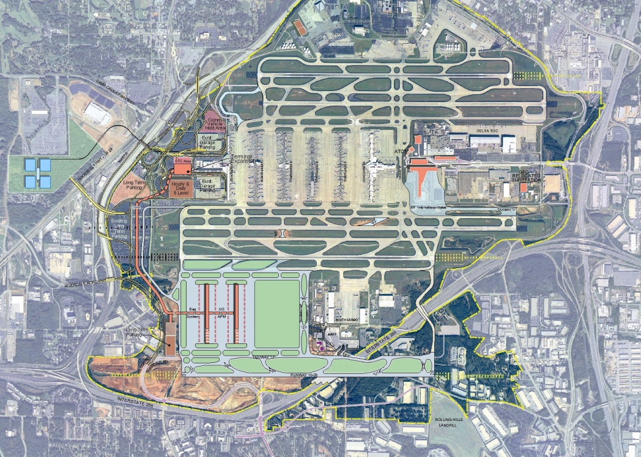

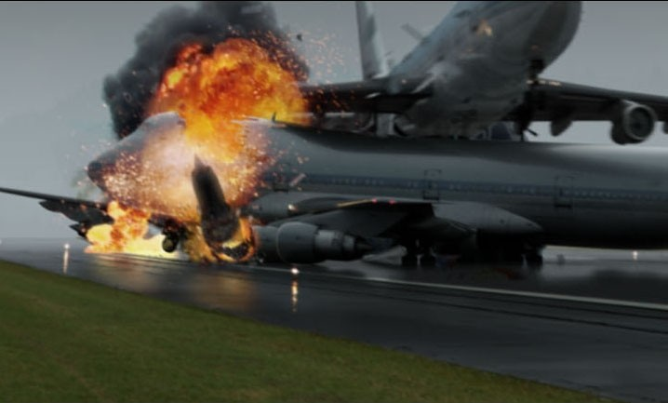
II) Flights and Speed Related Problems
Flight Scheduling
Time it takes a plane to travel a certain distance
Turbulence
Wind speed
Flight schedules can be significantly affected in airports when plane speeds are changing
Hartsfield-Jackson Atlanta International Airport
Over 930,000 flights a year!!

Slide 9
EX: The distance from Vancouver to Toronto to is 3400KM. A plane travels to Toronto with a tail wind and on the way back with a constant head wind with the same wind speed. a) Find an equation for the total time of a round trip. b) If the wind speed was 50km/h how fast must the plane fly to complete a round trip in 9hours?
Gather Information
Equation:

Slide 10
b) How fast must we fly to arrive within 9 hours?

Slide 11
Ex: The flight distance from Vancouver to HK is 10300km. If the wind speed is 60km/r, how fast must a plane fly if a round trip will take 25hours?

Slide 13
1st step: Make a chart
 | Distance | Speed | Time
Ero
Jamal
How much more time did Jamal needed more Ero?
So Jamal’s time subtract Ero’s time will be 2 1/3 hours
Now solve this equation

Slide 14
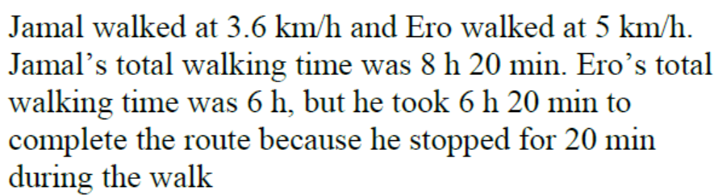
Find the LCD: 3(x)(x+1.4)
Multiply all terms by the LCD to get rid of the denominator
Use the QF or Factor
Can’t have a negative speed

Slide 15
1st step: Make a chart
 | Distance | Speed | Time
Arshia
Sarah
Arshia’s break was 30 minutes, so she had 30 minutes less time to travel
She also arrived 15 minutes later, so needing 15 minutes more to finish
Overall, she had 15minutes less than Sarah, that’s ¼ hours

Slide 16
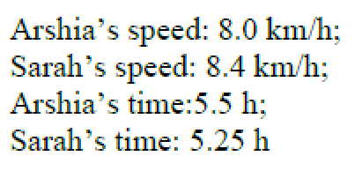

Slide 17
1st step: Make a chart
 | Distance | Speed | Time
Up Stream
Down Stream
Total time was 16 hours
Now solve equation!!

Slide 18
The speed of the current is 5km/hr

Slide 19
1st step: Make a chart
 | Distance | Speed | Time
Up Stream
Down Stream
Total time was 6 hours
Now solve equation!!

Slide 20
John was rowing at 6km/hr

Slide 21
1st step: Make a chart
Profit = Revenue - Expense
 | # of Shirts | Cost per Shirt | Total Amount
Expense and Cost
Revenue Sales

Slide 22
Jaime sold 18 shirts

Slide 23
1st step: Make a chart
 | Number of Days | Cost per Day | Total Amount
Original Plan
Actual Plan

Slide 24
Stuart expected to finish the job in 12 days. However, he ended spending 16 days to finish the job

